Slide 1
SpeechSentio AI-powered Speech therapy with Emotion Analysis
Team-15
20R21A6609 B.Amulya
20R21A6621 J.Pavithra
20R21A6627 K.Abhinay
20R21A6652 V.Lohitha
Guide Name:
Mrs.G.Aishwarya
Notes:
ID=d924773e-9a16-4d6d-9803-8cb819e99682 Recipe=text_billboard Type=TextOnly Variant=0 FamilyID=AccentBoxWalbaum_Zero

Slide 2

Contents
Problem statement
Introduction
Objectives
Proposed System Architecture
Solution
Output
Conclusion

Slide 3



Problem Statement
Individuals facing speech disfluency encounter challenges in accessing comprehensive therapy solutions, particularly lacking emotion recognition. Existing websites lack emotion analysis, hindering accurate identification of natural stuttering versus emotion-triggered stuttering. Our project addresses this gap by integrating AI-powered speech therapy with emotion analysis, empowering users to receive tailored recommendations for effective treatment.

Slide 4
Introduction
SpeechSentio stands as a pioneering system revolutionizing the landscape of stuttering detection, seamlessly integrating the formidable capabilities of machine learning, signal processing techniques, and emotion analysis. In the intricate domain of speech disorders, specifically stuttering, SpeechSentio distinguishes itself by not only pinpointing instances of stuttered speech but also immersing itself in the emotional nuances that accompany these occurrences. Through the strategic use of advanced algorithms, SpeechSentio conducts a multifaceted analysis, offering a comprehensive understanding of both the speech disorder and the emotional context surrounding it.

Slide 5

Objectives
Real-time analysis for pinpointing stuttering challenges and crafting precise interventions.
Emotional intelligence integration to create a supportive therapy environment, reducing anxiety and enhancing motivation.
Personalized pronunciation practice through in-depth analysis of individual speech patterns, optimizing practice time and accelerating progress toward fluency goals.

Slide 6
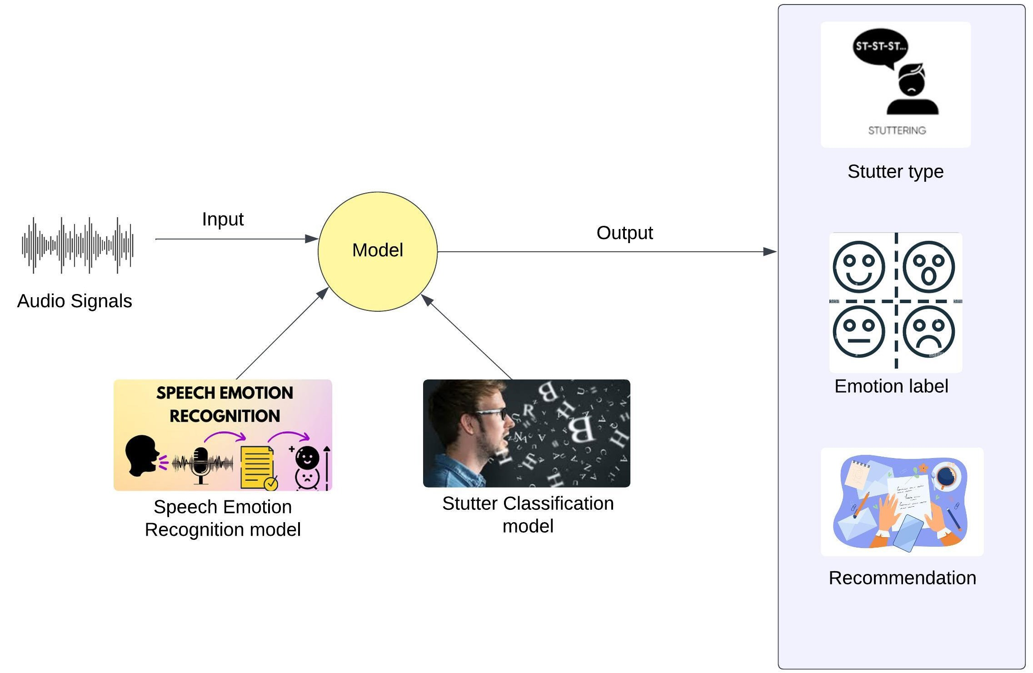
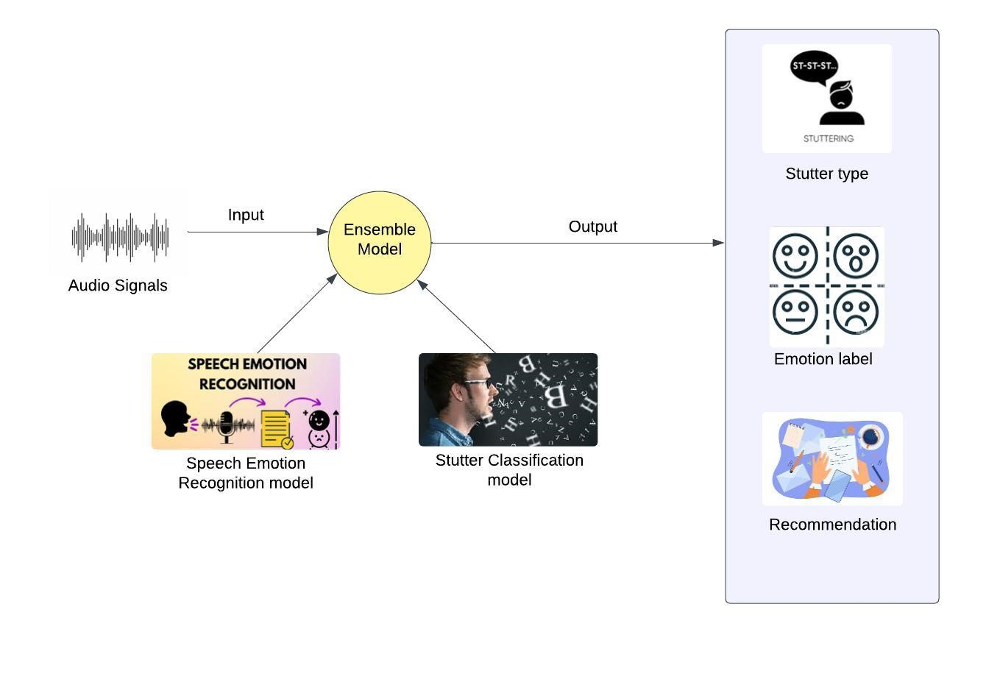
Proposed System Architecture

Slide 7
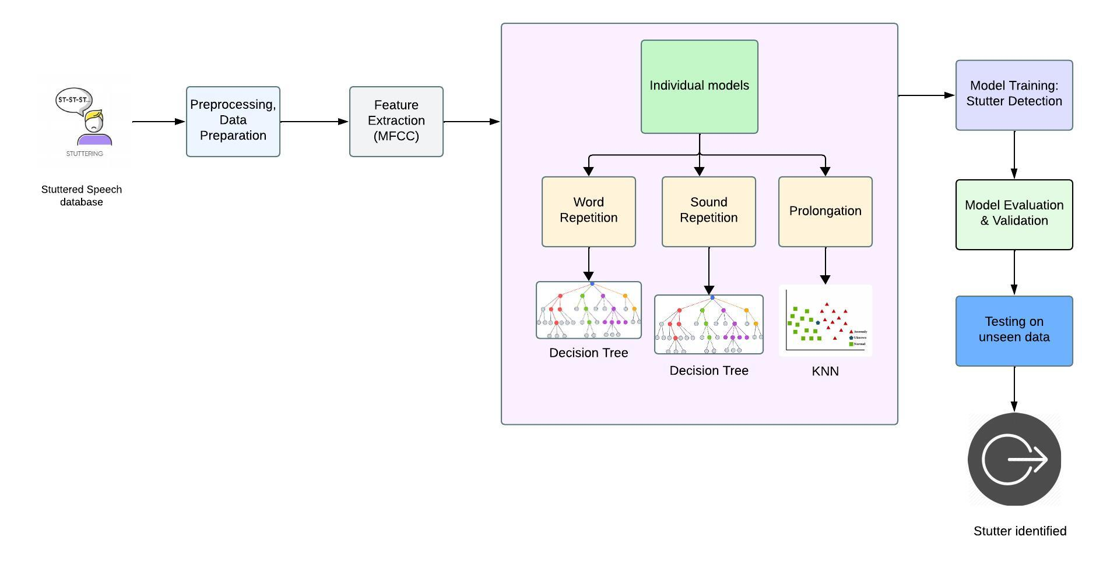
Stutter detection model

Slide 8
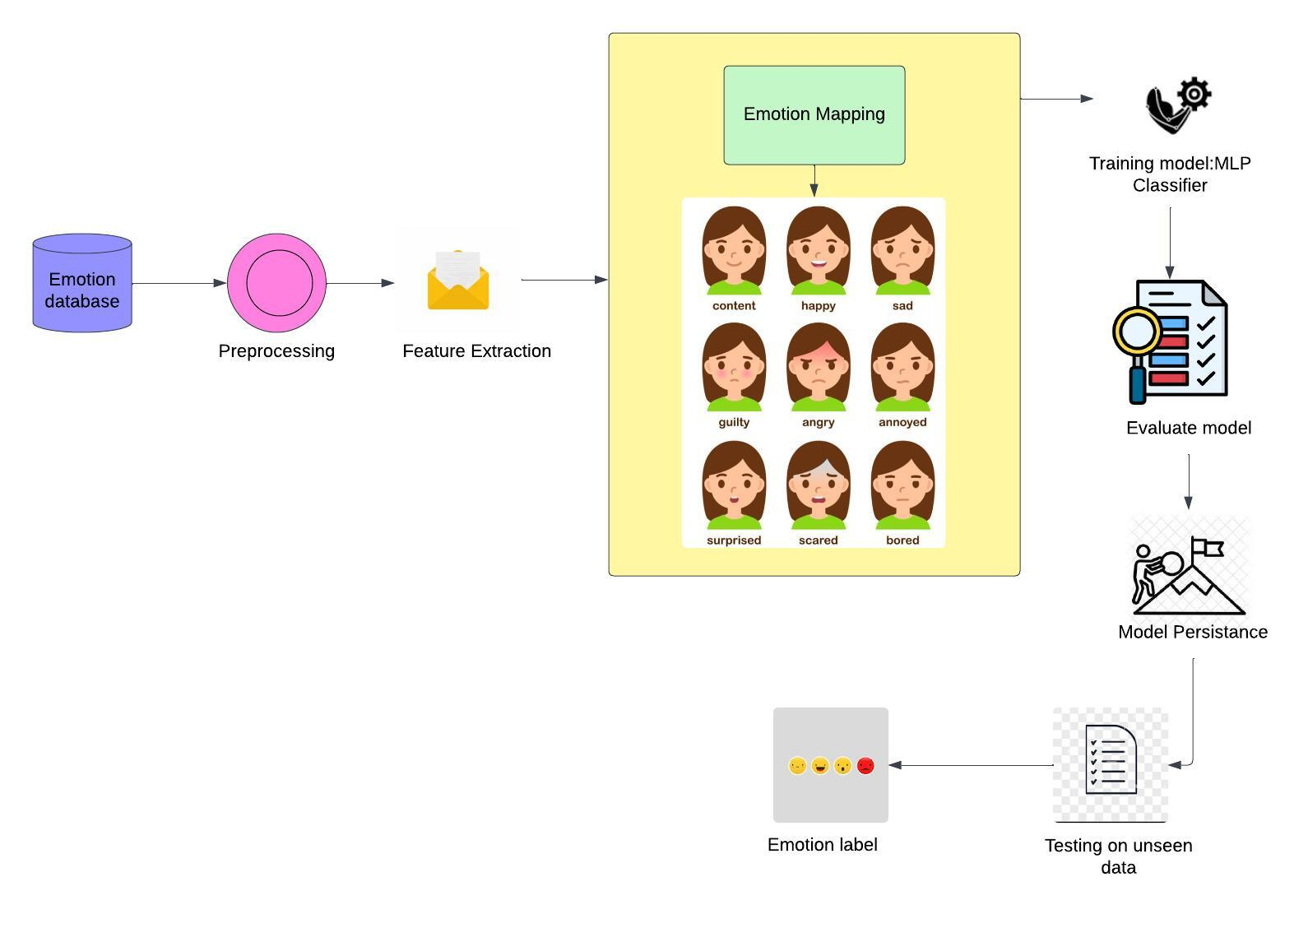
Speech Emotion Recognition Model

Slide 9
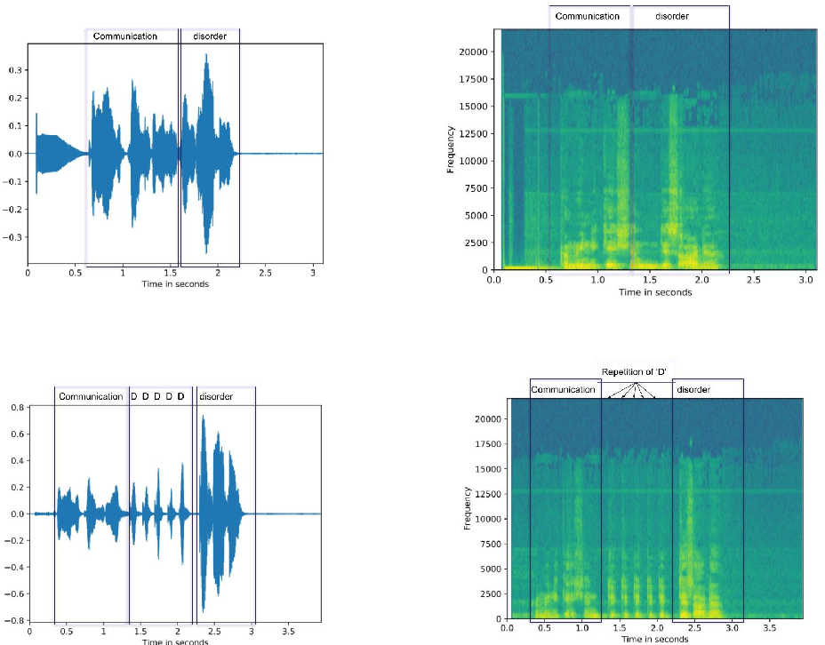
Solution
The proposed system “SpeechSentio” is a revolutionary speech therapy solution that breaks free from the limitations of traditional approaches. It leverages the power of artificial intelligence to personalize therapy, empower patients, and accelerate progress. By combining real-time data analysis, emotional intelligence, and personalized interventions, SpeechSentio removes the guesswork from speech therapy and creates a data-driven path to fluent, confident communication.

Slide 10
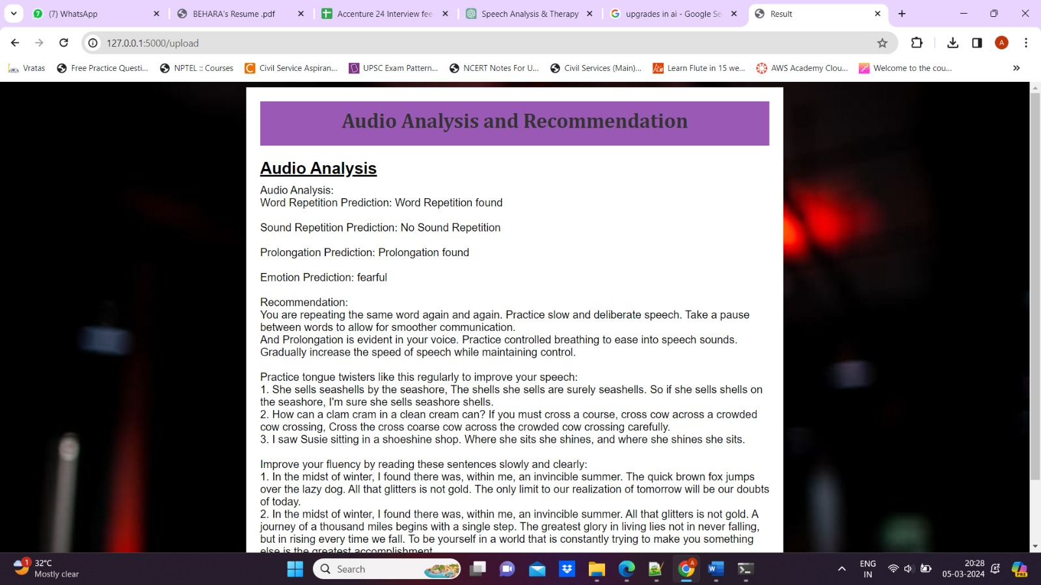
OUTPUT

Slide 11



Conclusion
In conclusion, our speech therapy app is a personalized and engaging way to improve speech skills. It uses artificial intelligence to tailor the exercises to the individual user's needs. We believe that this application has the potential to help people of all ages improve their speech skills and live more fulfilling lives.

Slide 12
THANK YOU!

